Slide 1



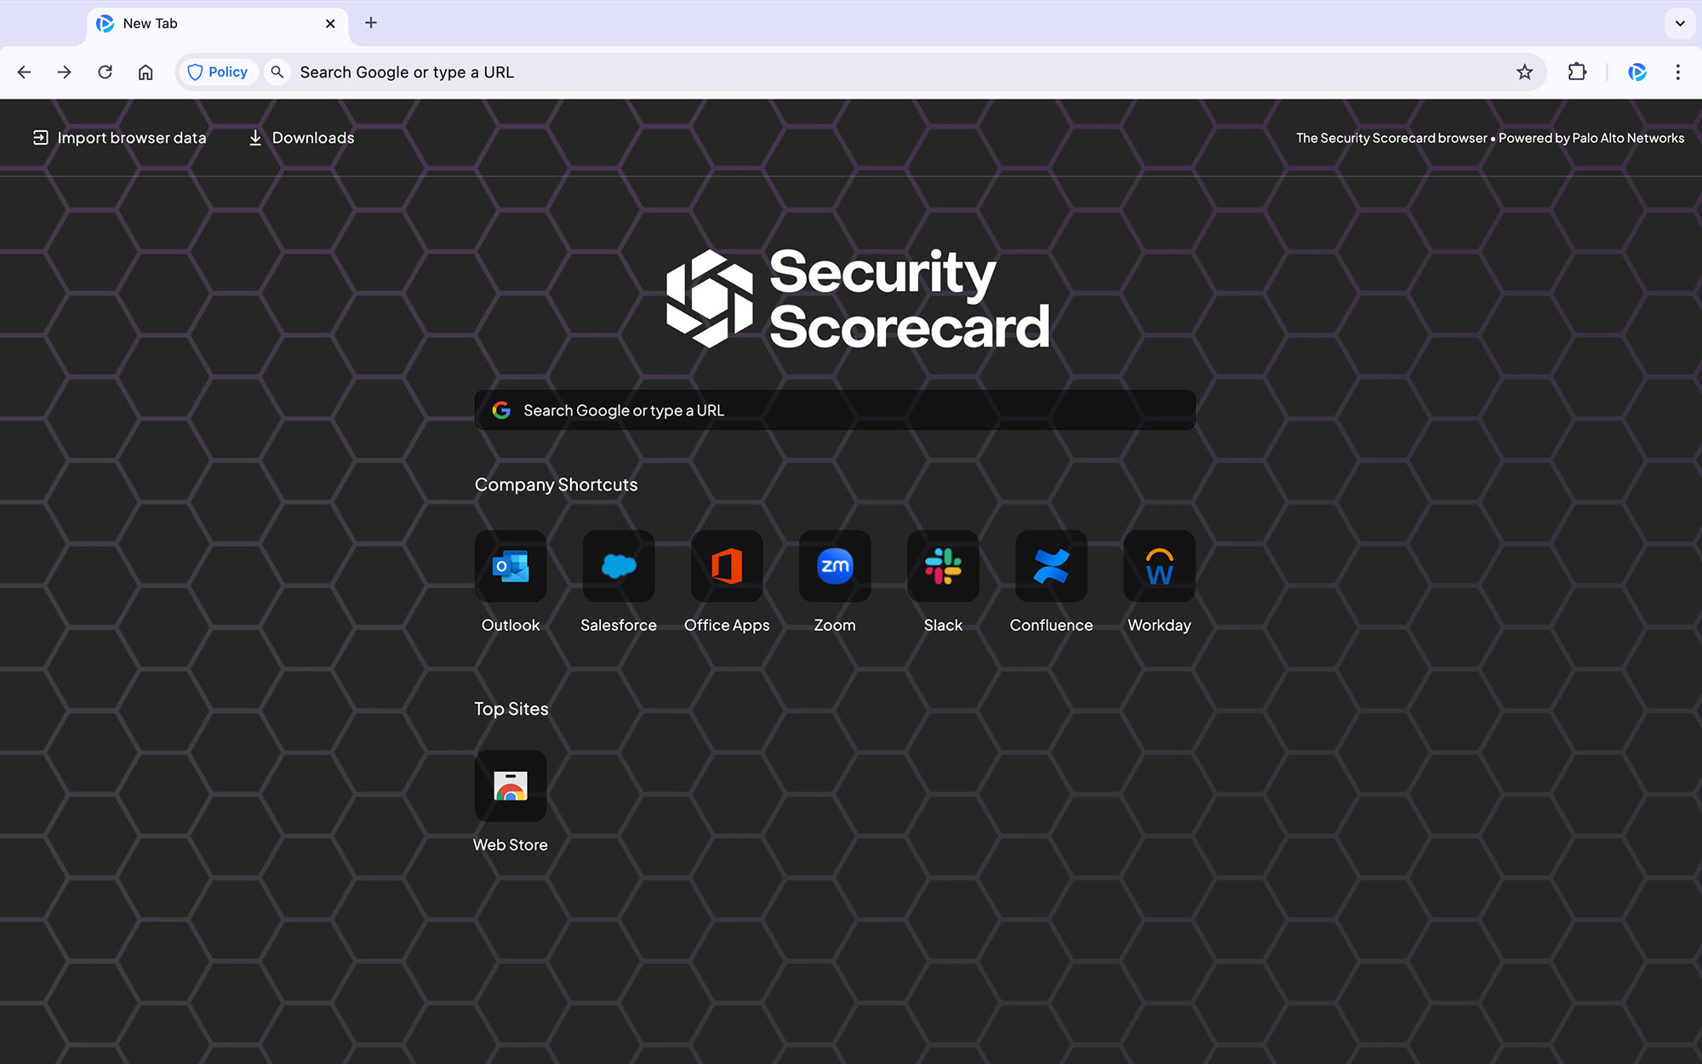
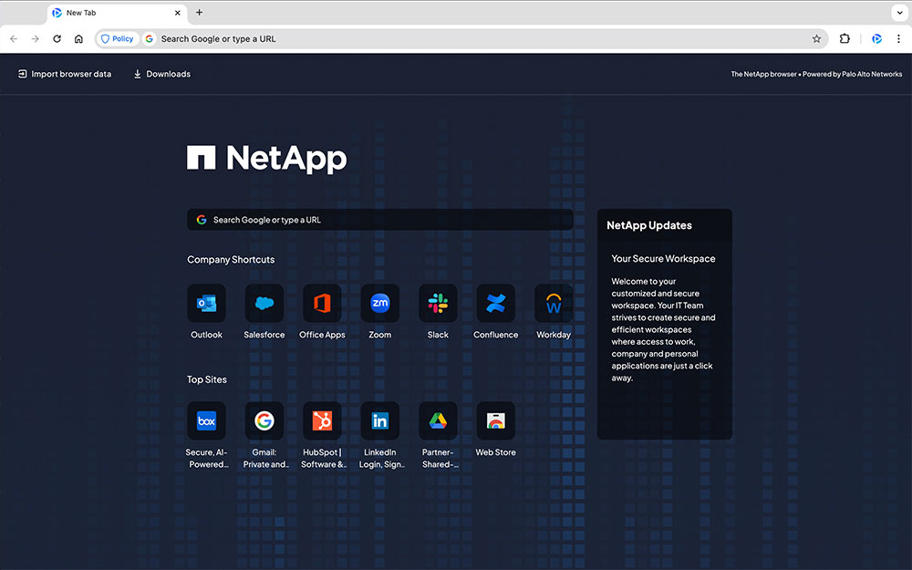

Securing the
Browser-Driven Workspace
How to protect work when everything happens in the browser
Hybrid work. SaaS. GenAI. BYOD.
Your users now live in the browser – attackers do too.
Partner logo
Presented by <Partner Name>

Slide 2


SECTION 1:
THE THREAT LANDSCAPE
Securing the
Browser-Driven
Workspace
The browser is the new workspace
SECTION 2:
The Browser Is
the New
Workspace
SECTION 3:
Security Spend vs
Browser Blind Spot
Recent workforce research shows that around 85% of work is now done through browsers and SaaS apps. Source: Omdia, “State of Workforce Security”, 2025.
The same research highlights that browser-based attacks are now a major vector for compromise, making the browser a critical control point.
A BYOD and mobile security survey found over 80% of organisations allow some form of bring-your-own-device (BYOD). Source: Cybersecurity Insiders, BYOD & Mobile Security Report.
In Australia, a 2024 employee risk survey found that 60% of workers admit to bypassing cybersecurity policies for convenience, and around 80% use personal devices to access workplace systems. Source: CyberArk, Employee Risk Survey (Australia), 2024.
85%
SECTION 4:
of work happens in browsers & SaaS
Four Browser
Problems
SECTION 5:
What 'Good'
Looks Like
Source: Omdia, State of Workforce Security, 2025
SECTION 6:
Enterprise Browsers:
Closing the Gap
SECTION 7:
80%+
Why Prisma
Browser
of Australian employees use personal devices for work
SECTION 8:
Start Small:
30-Day Pilot
Source: CyberArk, 2024
Your employees live in the browser, often on personal devices and outside traditional controls.

Slide 3
SECTION 1:
THE CHALLENGE
Securing the
Browser-Driven
Workspace
Security spend is high – but the browser is still a blind spot
SECTION 2:
The Browser Is
the New
Workspace
SECTION 3:
Security Spend vs
Browser Blind Spot
Australian Signals Directorate data shows around 85,000 cybercrime reports in a single year – roughly one every six minutes. Source: ASD Annual Cyber Threat Report.
ASD reporting indicates average losses per cybercrime incident in the tens of thousands of dollars for Australian businesses, with costs rising year on year.
A global browser-security study reported a near 200% increase in browser-based phishing attacks over a six-month period. Source: Menlo Security, “State of Browser Security”, 2023.
Verizon’s Data Breach Investigations Report notes that around two-thirds of breaches involve the human element, such as phishing or user error. Source: Verizon, Data Breach Investigations Report, 2024.
In Australia, the OAIC reports that 30% of data breaches are caused by human error, 12% by phishing, and 5% by rogue insiders. Source: Office of the Australian Information Commissioner, Notifiable Data Breaches Report, Jan–Jun 2024.
Traditional controls see traffic, devices and apps – but often cannot see or control detailed user actions inside SaaS on unmanaged browsers.
Cloud & App Security
SECTION 4:
Four Browser
Problems
Network Security
SECTION 5:
What 'Good'
Looks Like
SECTION 6:
Endpoint Security
Enterprise Browsers:
Closing the Gap
SECTION 7:
Browser Session
⚠ Limited visibility & control
Why Prisma
Browser
SECTION 8:
Start Small:
30-Day Pilot
Cybercrime every ∼6 min – ASD
30% of breaches are human error – OAIC
200% spike in browser phishing – Menlo Security
You’ve invested in security, but the user’s browser session – especially on personal devices – remains under-protected.

Slide 4
SECTION 1:
ROOT CAUSE
Securing the
Browser-Driven
Workspace
Four browser problems we see everywhere
SECTION 2:
The Browser Is
the New
Workspace
SECTION 3:
With most work in browsers and many Australians using personal devices for access, organisations keep running into the same four issues.
Security Spend vs
Browser Blind Spot
Contractors & partners
GenAI & shadow SaaS
SECTION 4:
Four Browser
Problems
External users access critical apps from personal or lightly managed devices.
Staff paste or upload sensitive data into GenAI tools and unsanctioned SaaS apps.
SECTION 5:
What 'Good'
Looks Like
SECTION 6:
Enterprise Browsers:
Closing the Gap
SECTION 7:
Why Prisma
Browser
VDI overkill
Limited forensics
SECTION 8:
Full virtual desktops are used purely to provide “safe” browser access, adding cost and latency.
After a SaaS incident, it’s hard to reconstruct what happened in the browser: who accessed what, from where, and what they did.
Start Small:
30-Day Pilot
Different symptoms, same root cause: the browser isn’t treated as a first-class security control point.

Slide 5

SECTION 1:
WHAT ‘GOOD’ LOOKS LIKE
Securing the
Browser-Driven
Workspace
Design principle: secure work in the browser, on any device
SECTION 2:
The Browser Is
the New
Workspace
SECTION 3:
Security Spend vs
Browser Blind Spot
Treat the browser as an enterprise control point, not just a consumer app.
Apply consistent security policy across managed and unmanaged devices – employees, contractors and partners.
Enforce data and identity controls inside SaaS and web apps (uploads, downloads, copy/paste, printing, screenshots, GenAI usage).
Provide session-level visibility: who did what, in which app, from which device, and when.
Deliver a simple user experience so users just open the browser, log in and work.
Industry analysts expect secure enterprise browsers to move from early adoption to mainstream over the next few years as part of Zero Trust architectures. Source: Gartner and related secure enterprise browser research, 2025.
SECTION 4:
Corporate
laptop
Contractor
device
Four Browser
Problems
SECTION 5:
Secure
Browser
What 'Good'
Looks Like
SECTION 6:
Enterprise Browsers:
Closing the Gap
SECTION 7:
Why Prisma
Browser
“Secure browser technologies are forecast to see strong enterprise adoption by 2028” – Gartner
SECTION 8:
Mobile / BYOD
Start Small:
30-Day Pilot
Same controls and visibility, regardless of device – without punishing users.

Slide 6
SECTION 1:
THE SOLUTION
Securing the
Browser-Driven
Workspace
Secure enterprise browsers: closing the gap
SECTION 2:
The Browser Is
the New
Workspace
SECTION 3:
Security Spend vs
Browser Blind Spot
A secure enterprise browser embeds security and data controls directly into the browser.
It enforces Zero Trust access and DLP for web, SaaS and private apps – even on unmanaged endpoints.
It gives security teams rich visibility into browser-level activity for investigations and compliance.
It can replace some VDI use cases for browser-only workloads, reducing cost and complexity.
Analyst forecasts suggest that fewer than 10% of organisations use secure enterprise browsers today, but around a quarter will adopt them by 2028 to strengthen remote access and endpoint security. Source: Gartner, Secure Enterprise Browser predictions, 2025.
Users & Devices
SECTION 4:
Four Browser
Problems
SECTION 5:
Secure Enterprise Browser
What 'Good'
Looks Like
SECTION 6:
Enterprise Browsers:
Closing the Gap
SaaS / Web / Private Apps
SECTION 7:
Why Prisma
Browser
SECTION 8:
Start Small:
30-Day Pilot
Secure enterprise browsers:
<10% adoption today → ∼25% by 2028
– Gartner
One of the cleanest ways to implement this model – especially in a SASE environment – is Prisma Browser from Palo Alto Networks.

Slide 7
SECTION 1:
OUR PREFERRED APPROACH
Securing the
Browser-Driven
Workspace
Why Prisma Browser is our preferred approach
SECTION 2:
The Browser Is
the New
Workspace
SECTION 3:
Security Spend vs
Browser Blind Spot
Prisma Browser is a secure enterprise browser built into the Prisma SASE platform from Palo Alto Networks.
It lets you secure any user, on any device, accessing any app – including contractors and BYOD users.
It leverages Prisma SASE’s AI-driven threat intelligence to detect highly evasive browser-based threats.
It delivers last-mile data protection with granular controls for uploads, downloads, copy/paste, screenshots, printing, watermarks and more – directly in the browser.
Prisma SASE is a globally adopted platform with large-scale enterprise deployment and multi-billion-dollar recurring revenue, so Prisma Browser benefits from a proven, mature cloud security fabric.
The Secure Browser Edge
SECTION 4:
Four Browser
Problems
Prisma SASE cloud with Prisma Browser
SECTION 5:
Threat Intelligence
1
What 'Good'
Looks Like
AI-powered detection
SECTION 6:
Enterprise Browsers:
Closing the Gap
Data Protection
2
SECTION 7:
Last-mile DLP in browser
Why Prisma
Browser
SECTION 8:
Any Device / Any App
Start Small:
30-Day Pilot
Managed & unmanaged
3
Prisma Browser turns your browser into an extension of Prisma SASE – not a separate point solution.

Slide 8
SECTION 1:
THE NEXT STEP
Securing the
Browser-Driven
Workspace
Start small: 30-day browser security pilot
200+ USERS
SECTION 2:
The Browser Is
the New
Workspace
SECTION 3:
Where to start
Pilot structure with Prisma Browser
Security Spend vs
Browser Blind Spot
Contractors & third parties Secure access to 1–2 key apps from personal devices with strong access and data controls.
Selected BYOD / remote users Allow a defined group to use personal devices while maintaining corporate-grade visibility and control.
GenAI guardrails Enable specific teams to use GenAI tools with policies that prevent sensitive data from entering prompts.
VDI reduction Move a browser-only workflow off VDI for a pilot group and compare cost, performance and risk.
Scope Minimum 200 users (aligned to Prisma Browser licensing), typically 200–300 users across one or two clearly defined use cases.
Success metrics Adoption: percentage of pilot users actively using Prisma Browser by week three. Risk reduction: number and type of blocked risky events and policy violations. User experience: pilot user feedback compared with the current approach (VDI, VPN, or native browser). Operational impact: time to onboard users versus shipping devices or provisioning full VDI.
Timeline Week 0 – Design: agree cohort, apps, policies and success criteria. Weeks 1–3 – Deploy: onboard 200+ users, tune policies, weekly check-ins. Week 4 – Review: summarise results and agree the expansion plan.
SECTION 4:
Four Browser
Problems
SECTION 5:
What 'Good'
Looks Like
SECTION 6:
Enterprise Browsers:
Closing the Gap
SECTION 7:
Why Prisma
Browser
SECTION 8:
Start Small:
30-Day Pilot
Next step: identify your first 200-user cohort and schedule a pilot design workshop.

