Slide 1
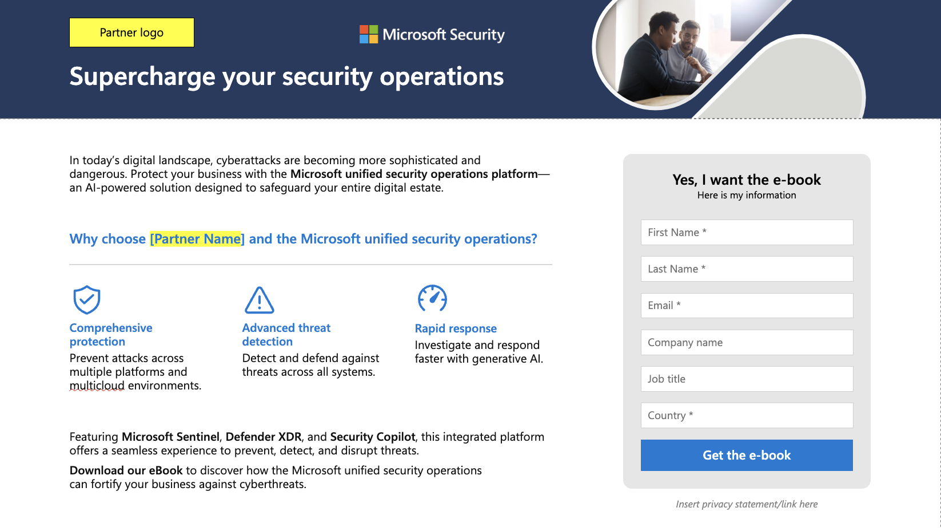
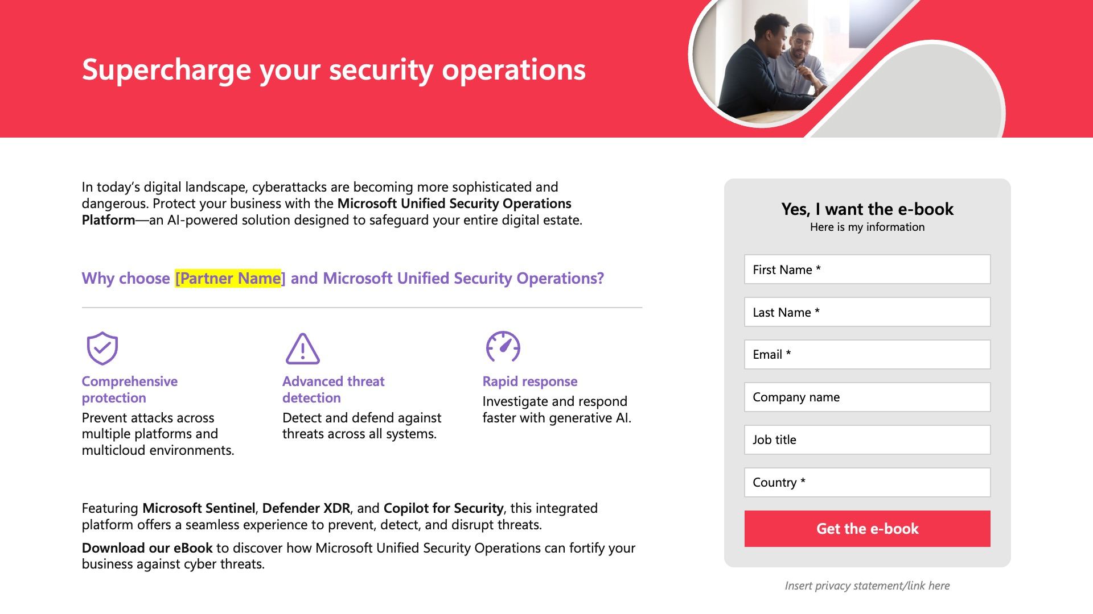
Partner customization guidance
This template provides an example that can be customized for your brand and taken advantage of as a starting point for creating your own gated landing page hosted on your website or elsewhere. The text provided is directed at the e-book but can be adapted and used for gating the infographic as well.
(See the example to right for how the original template colors, logos, etc. can be customized.)
2
Replace all instances of “Partner Name” or “Partner Solution” with your own company/solution name and add any additional partner-specific content where identified. Be sure to remove the yellow highlighting and change the font color to match the surrounding text.
3
Change the gray color blocks, overlays, icons, and text headlines to your own brand color(s). See the example to the right.
Yellow highlights in this template indicate the areas where text or graphics should be customized for your brand.
Original template color scheme
1
Replace the “Partner Logo” placeholder with your company logo where applicable.
Per Microsoft Partner Brand Guidelines, ensure your logo is 120 percent of the size of the Microsoft 365 logo.
See more partner co-branding guidance here.
4
Lead collection form is shown as an example only. You will need to create your own form, including which input fields that you would like to collect from customers. Best practice is to require as few fields as possible. Also, be mindful of your use of PII (personally identifying information) that you collect and be sure to include any applicable disclaimers regarding your use of the collected information on the landing page.
Example of template that has been customized with brand colors, logo, and icons

Slide 2





Partner logo
Supercharge your security operations
In today’s digital landscape, cyberattacks are becoming more sophisticated and
dangerous. Protect your business with the Microsoft unified security operations platform—an AI-powered solution designed to safeguard your entire digital estate.
Yes, I want the e-book
Here is my information
First Name *
Why choose [Partner Name] and the Microsoft unified security operations?
Last Name *
Email *
Comprehensive protection
Prevent attacks across multiple platforms and multicloud environments.
Advanced threat detection
Detect and defend against threats across all systems.
Rapid response
Investigate and respond faster with generative AI.
Company name
Job title
Country *
Featuring Microsoft Sentinel, Defender XDR, and Security Copilot, this integrated platform offers a seamless experience to prevent, detect, and disrupt threats.
Download our eBook to discover how the Microsoft unified security operations
can fortify your business against cyberthreats.
Get the e-book
Insert privacy statement/link here

