Slide 1


Defend Against Cybersecurity Threats
Campaign-in-a-Box
Execution Guide
Partner marketing resources to generate interest and qualify intent
August 2024

Slide 2

Table of contents
Campaign overview:
    Message for partners
    Demand generation overview
Target the ideal audience:
    Audience
    Messaging framework
    Campaign copy blocks
Build your campaign:
    Campaign journey
    PMC asset library
Activate, track, and close sales:
    Checklists and guidance

Slide 3
Launch a security solutions campaign to drive awareness, generate leads, and initiate sales engagement opportunities.
Defend Against Cybersecurity Threats
Campaign-in-a-Box
The Microsoft unified security operations platform offers comprehensive threat protection, delivering prevention, detection, investigation, and response across a customers’ entire multiple-platform, multicloud digital estate. This enables them to supercharge their security with an AI-powered solution​.
Give customers visibility across their entire organization.​
Secure end users and infrastructure.​
Reduce time to investigate threats by 65 percent.¹
Save 60% when investing in Microsoft end-to-end security.³
Upgrade your customer’s security with an AI-powered unified platform. The Defend Against Cybersecurity Threats campaign drives top-of-the-funnel leads​, builds customer intent​, and provides
mitigation recommendations.
Use this guide and associated materials to create your own sales and marketing campaign that highlights the benefits of Microsoft security solutions and your services as a trusted Microsoft advisor.
This campaign is aligned with the FY24 Threat Protection XDR and SIEM
solution play.
¹Microsoft research
²Based on the USD12 per user Microsoft 365 E5 Security add-on to Microsoft 365 E3 compared to the USD30 average per user multiple-vendor security solution.

Slide 4
Demand generation campaign overview
Build a pipeline of qualified prospects and drive interest for your service or solution. Take advantage of targeting and message guidance, campaign journey, asset templates, activation checklist, and timeline to generate new leads.
Share pipeline opportunity progression via Partner Center
Connect
Follow-up with qualified leads in 1:1 conversations to secure interest and conversion.
Execute
Promote your solution and generate demand with step-by-step full-funnel campaign execution guidance.
Build
Qualify customers for 1:1 engagement
Customize
provided marketing assets with your solution value prop and business messaging for a co-branded campaign.
Target
Build your pipeline by identifying high-value target accounts and combine with
priority prospects.

Slide 5



Priority audiences
CISO, CIO (BDM)
Cares about:
A company’s entire security strategy and its complexities: protecting against a data breach, meeting industry data compliance regulations, establishing and refining employee management while developing protocols to reduce human error
Pain points:
Making sure the corporation has the best security technology, without compromising on cost
Ensuring employees can safely work from anywhere, while keeping corporate information safe
The rise of AI, and how it affects employees
and security
Security operations manager (influencer)
Cares about:
Overseeing the security operations team; responsible for organization-wide security, data loss prevention, cybercrime complexity, endpoint management, and overall digital transformation.
Pain points:
Identity, threat, and information protection
Ransomware and business email compromise
(BEC) attacks
Security: Endpoint and cyberthreats increasing gaps
Lack of budgetary and security analyst resources
Expanding scope and scale of attacks
Security architect (influencer)
Cares about:
Planning, designing, building and testing security solutions and capabilities. Responsible for identifying areas of strength and weakness
Pain points:
Tool fragmentation/security
Lack of governance and compliance
Securing user access with rise of remote work
Operational visibility

Slide 6
Messaging framework
Prevent breaches across your multiple-platform, multicloud environment
Continuously manage threat exposure.
Monitor security controls and model potential attack paths.
Prevent repeat attacks.
Improve security posture.
Defend Against Cybersecurity Threats
Detect and defend against threats with near real-time protection
Automatically disrupt in-progress attacks.
Detect and defend across the entire
kill chain.
Get end-to-end visibility in one place.
Deceive attackers and protect your critical assets.
Key customer outcomes
An integrated SIEM and
XDR solution
Best-in-class threat prevention, detection, and response across the entire kill chain
An end-to-end experience for detecting, investigating, responding to, and protecting against cyberthreats
Rapidly remediate threats with generative AI
Respond to incidents at the speed of generative AI.
Supercharge security operations
center productivity.
Report on security without any heavy lifting.

Slide 7
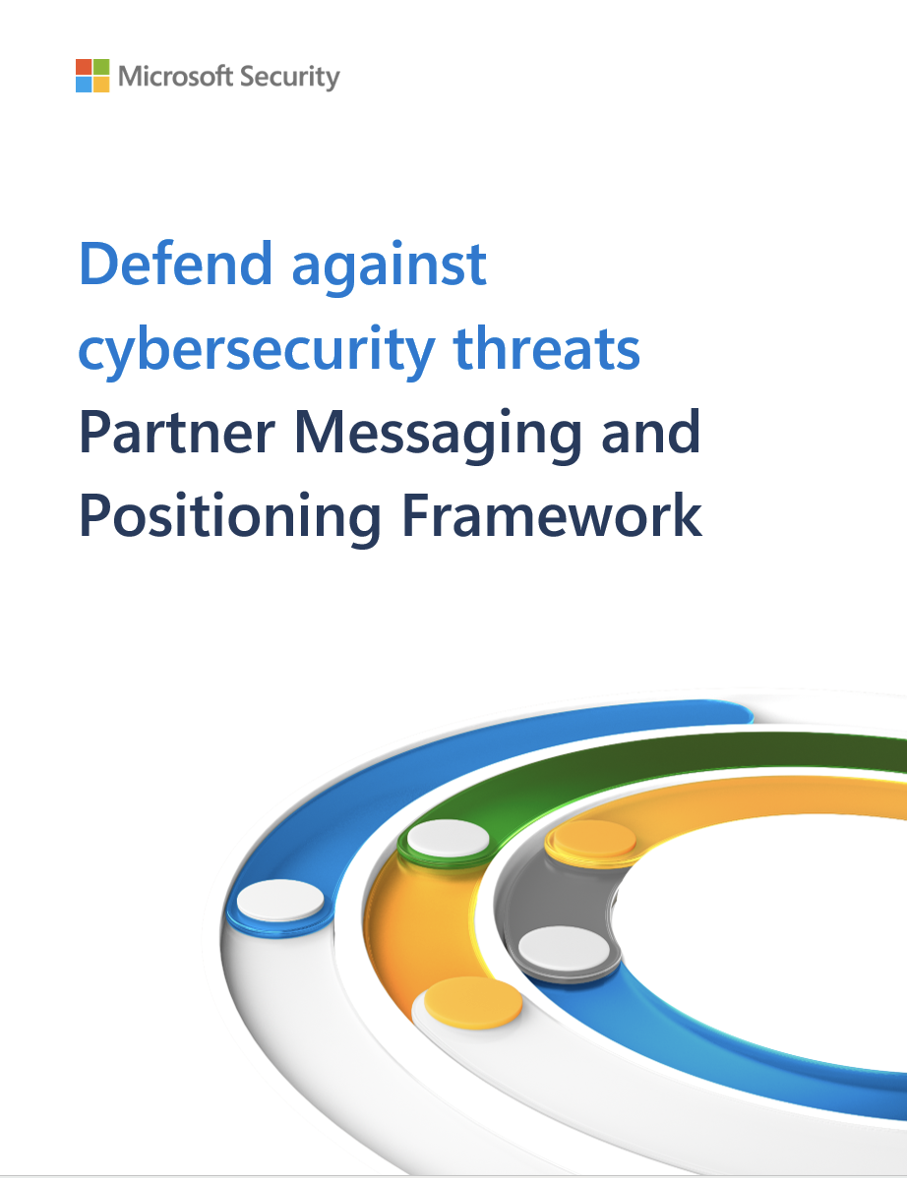
Defend against cybersecurity threats
To learn more about the Microsoft unified security platform and how to position it when talking with customers, refer to the messaging and positioning document.
Messaging includes:
Market context
Aligned scenarios
Aligned products
Audience
Elevator pitch
Copy blocks
Value pillars
Use cases

Slide 8
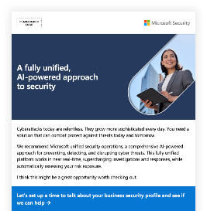
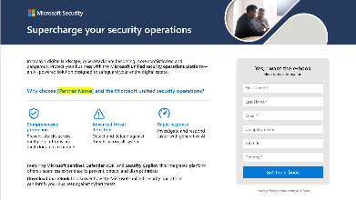
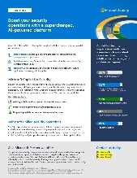
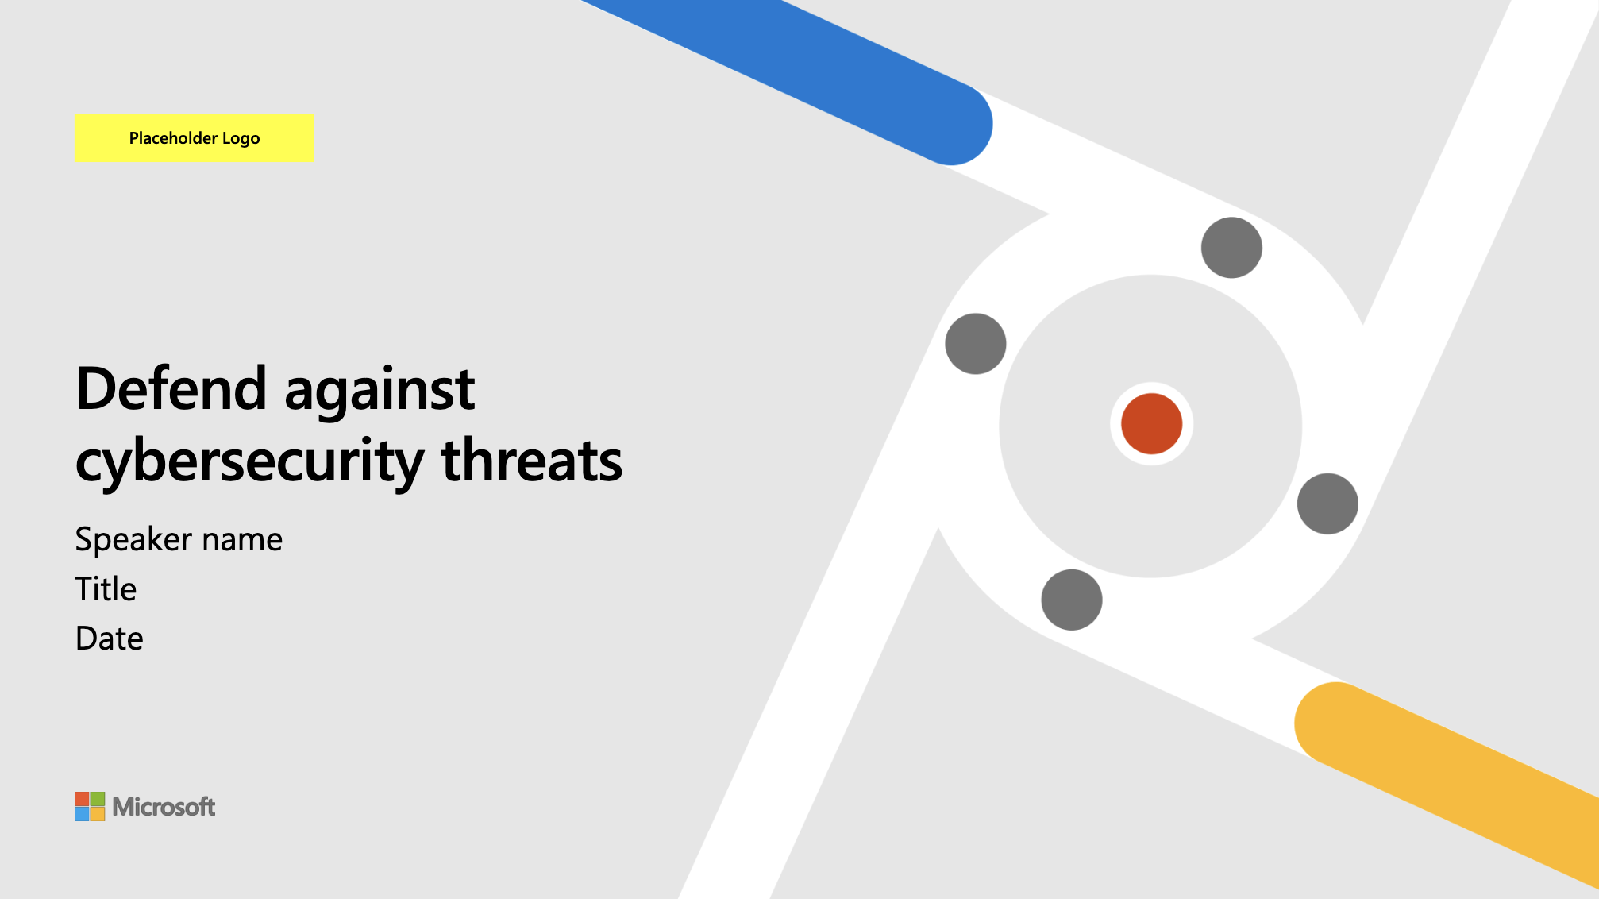
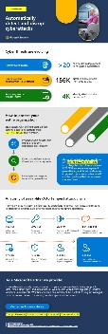
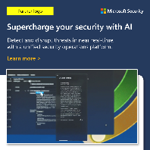
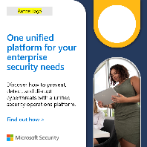
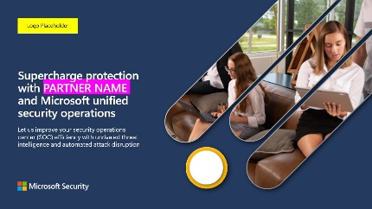
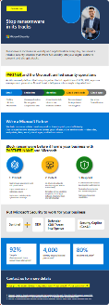
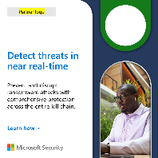
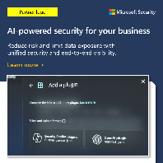
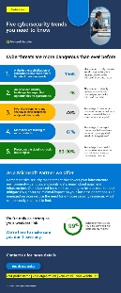
Demand generation campaign journey
Sequence your campaign with the following marketing touchpoints, using templates in the asset library.
1. PROMOTION
2. ACQUISITION
3. CONSIDERATION
4. DECISION
The hero asset is promoted to target audiences via social and display ads. Promo emails are sent to existing known contacts.
Visitors who engage with the e-book will receive a multiple-email nurture series, surfacing mid-funnel assets to enhance consideration. As they progress through the nurture campaign and show behavioral indicators, they are qualified for hand-off to sales.
Leads pass to sales following nurture and qualification. Customer participates in a 1:1 meeting to determine next steps (including potential partner-led engagement). ​
Email nurture
Email #1
Partner-led outreach
Send to existing known contacts to capture interest and promote the hero asset.
DATA SHEET
GenAI and Threat Protection
Contact sales
Yes
Promo email
Gated landing page
No
Email #2
Pitch deck
INFOGRAPHIC #2
Detect and Disrupt in progress cyberattacks
Leverage as paid or organic social ads to drive traffic to a campaign landing page for the hero asset.
Contact sales
Yes
No
Messaging guidance
Email #3
INFOGRAPHIC #3
Stop Ransomware in it's tracks
E-book:​ Supercharge protection with <PARTNER NAME> and Microsoft unified security operations
Contact sales
Yes
No
Social ads
Email #4
Partner MPF
INFOGRAPHIC #4
Six key cybersecurity trends
Contact sales
Yes

Slide 9
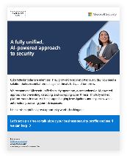
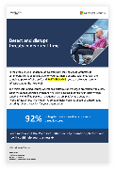
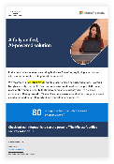
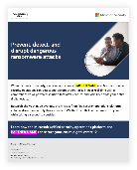
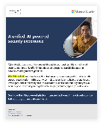
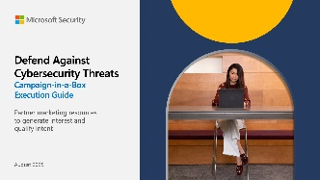

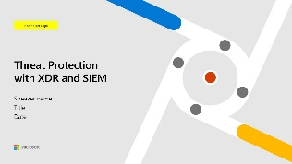
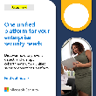
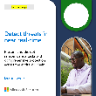
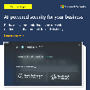



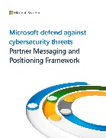
Campaign asset library
PROMOTION
ACQUISITION
CONSIDERATION
DECISION AND ENABLEMENT
Nurture
email 1
Nurture
email 2
Nurture
email 2
Nurture
email 4
Execution guide
Promo emails (#)
E-book:​ Supercharge protection with <PARTNER NAME> and Microsoft unified security operations
Social ads (#)
Pitch deck
Gated landing page
GenAI and Threat Protection Datasheet
Six Key Cybersecurity trends infographic
Detect and Disrupt infographic​
Ransomware infographic
Partner MPF
Customizing your assets
The campaign assets in this collection are templates that require partner customization.
Each asset will give specific instructions for you to make it your own, by modifying:
Brand font, logo, and colors.
Solution value proposition and details.
Call to action and company contact information.
Ready to start building your pipeline?
Check out the full range of campaign assets.
Get support in our partner portal.
Review Microsoft Partner-Led Marketing Guidelines.

Slide 10
Campaign guidance
Build your marketing campaign with these easy-to-follow checklists
1. PROMOTION
2. ACQUISITION
3. CONSIDERATION
4. DECISION
Social
Select the social platform (LinkedIn, X) where your audience engagement
is strongest.
Build a paid media plan, identifying budget and campaign dates for a lead acquisition campaign promoting one of the
hero assets and targeting priority audiences.
Customize social ad templates for your brand.
Be sure to direct the ads to where your hero assets are being hosted.
Incorporate organic promotion, posting via your brand handle.
Consider A/B testing different messaging variations and optimizing over the course of the campaign.
Email
Take advantage of priority audience guidance to build an email list with known prospects or existing customers.
Use the promotional email to promote the hero asset. Customize the OFT email files according to instructions.
Review results and optimize, refreshing subject lines and campaign messaging for resends to contacts who did not open previously. Consider A/B testing variations, such as recipient first name in the subject lines.
Display Ads
Customize the display ads for your own brand.
Identify the ad network you want to advertise through (e.g., Bing, Google, etc.), and whether you will run a broader PPC campaign or a more targeted campaign (displaying your ads to previous visitors
to your website, or people
in a particular location,
for example).
Set up your campaign parameters including budget and launch your campaign. Monitor and optimize your approach/audience.
Acquisition
Customize your campaign hero asset incorporating your CTA.
Host your asset on your web domain, creating a Gated landing page (requiring prospects to enter contact details to access the asset) to aid in lead collection.
Determine lead capture form requirements
that align with your
CRM structure and minimize required fields
to avoid drop-off.
Update promotional assets with the correct link to your hosted
landing page.
Nurture
Upload assets promoted via nurture to your marketing automation system.
Add links to corresponding emails.
Personalize the nurture email files with your solution details, contact info, privacy information, and CTA links.
Customize the
assets promoted in
the nurture emails (infographics)
following instructions
in each document.
Instrument the emails in your marketing automation system
and create lead scoring to qualify leads for
sales follow-up.
Sales follow-up
Provide the sales team an overview of the campaign, including a copy of your campaign assets.
Customize the pitch deck with your branding and messaging and deliver to customers in 1:1 meetings.
Familiarize yourself
with the Partner Seller Guide to prepare for
customer conversations.
Enter lead and qualification details into Partner Center. (See FAQs for help, here).
Ensure you use #PartnerGTM when sharing leads in Partner Center.

Slide 11
Threat Protection Engagement
Offer customers the opportunity to participate in the Threat Protection Engagement, which is designed to create intent for purchasing and/or deploying advanced Microsoft Security products, including but not limited to Microsoft Defender XDR and Microsoft Sentinel.
The Threat Protection Engagement helps customers assess their security landscape and address their most pressing security goals and challenges and provides an immersive experience that brings the Microsoft security vision and capabilities to life. It is about a three-day partner effort delivered over a five-week period in a customer’s production environment. You will work with customers to deliver:
A documented security strategy for their teams and stakeholders.
A better knowledge of their threat environment.
Details on how to understand, prioritize, and mitigate potential threats.
Assistance defining what steps to take next.
Access the engagement materials and guidance here:
Threat Protection Engagement

Slide 12
Customize your campaign assets

Slide 13
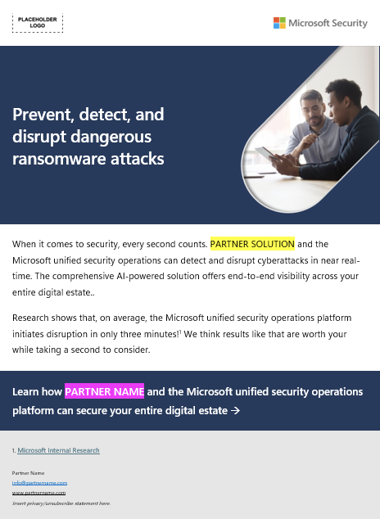
Customizing your emails
1
Replace logo placeholders with your own corporate logo. Ensure your logo is 120 percent the size of the Microsoft 365 logo per Microsoft Partner Brand Guidelines.
2
Replace the template font with your brand font, matching weights. (Note that font type sizes vary and you may need to adjust your size to fit). Banner and footer overlays can also be adjusted to fit your brand imagery/colors. Images included in this template must remain for use exclusively in this template and must not be altered or used elsewhere.
3
Add recipient name.
4
Replace all yellow highlighted areas with your own company name and benefit details where noted.
5
Link the “Download the infographic” (or e-book for email #2) text to your custom URL for the gated landing page.
6
Add your contact details, CTA, and applicable links.
7
Insert sender’s signature.
8
Insert your own copyright information, company info, and links to privacy policy and unsubscribe options.

Slide 14

Thank you

